Slide 1
Knowledge and Information Management

Slide 2
RECAP
Why the current interest in KM?
“knowledge is at the heart of much of today’s global economy, and managing knowledge has become vital to companies’ success”
(Kluge, et al (2001)
“this transformation from a world largely dominated by physical resources, to a world dominated by knowledge, implies a shift in the locus of economic power as profound as that which occurred at the time of the industrial revolution”
Burton-Jones (1999
Notes:
There is also a trend towards more complex problem-solving services where the
majority of employees are well-educated and creative, self-motivated people.
The knowledge economy is a system of consumption and production that is based on intellectual capital. In particular, it refers to the ability to capitalize on scientific discoveries and basic and applied research. This has come to represent a large component of all economic activity in most developed countries. In a knowledge economy, a significant component of value may thus consist of intangible assets such as the value of its workers' knowledge or intellectual property.
In a knowledge economy, Businesses should no longer be seen from an industrial, but from a knowledge perspective (Sveiby 1997, 26ff)
Today, for the first time in history, the
World  wealthiest person, Bill Gates, is a knowledge worker (Thurow 1997, 96).
Knowledge Worker: Knowledge workers are workers whose main capital is knowledge. Examples include programmers, physicians, pharmacists, architects, engineers, scientists, design thinkers, public accountants, lawyers, editors, and academics, whose job is to "think for a living".
Knowledge work1 can be characterized by a high degree of variety and exceptions
and requires a high level of skill and expertise. Knowledge work requires that
knowledge is continuously revised, and considered permanently improvable, not as
truth, but as a resource2.

Slide 3
Key themes in the knowledge society literature
Knowledge is of central importance to advanced economies
Knowledge is key to organisational performance
Organisations and work have become more knowledge intensive
Hislop, D. (2005) KM in organisations, OUP
Notes:
Knowledge as the key
resource, not labor, raw material or capital, changes production functions in organizations
significantly.

Slide 4
What is KM?
Knowledge management (KM) may simply be defined as doing what is needed to get the most out of knowledge resources.
In general, KM focuses on organizing and making available important knowledge, wherever and whenever it is needed.
KM is also related to the concept of intellectual capital, composed of both human & structural capital
(Chapter 1, Becerra et al.)

Slide 5
Why KM?
Sharing knowledge, a company creates exponential benefits from the knowledge as people learn from it
Building better sensitivity to “brain drain”
Reacting instantly to new business opportunities
Ensuring successful partnering and core competencies with suppliers, vendors, customers, and other constituents
Shortens the learning curve

Slide 6
KM justification
Is current knowledge going to be lost?
Is proposed system needed in several locations?
Are experts available/willing?
Can experts articulate how problem will be solved?
Is there a champion in the house?

Slide 7
Driving forces in KM
Increasing Domain Complexity
•Intricacy of internal and external processes, increased competition, and the rapid advancement of technology all contribute to increasing domain complexity.
Accelerating Market Volatility
The pace of change, or volatility, within each market domain has increased rapidly in the past decade.

Slide 8
Forces driving KM
Intensified Speed of Responsiveness
•The time required to take action based upon subtle changes within and across domains is decreasing.
Diminishing Individual Experience
•High employee turnover rates have resulted in individuals with decision-making authority having less tenure within their organizations than ever before.
Fragmentation of knowledge:
The latter argument also points to an increasing fragmentation of knowledge. Knowledge is spread over numerous experts, among organizational units, across organizations and does not stop at national borders.
Researchers have to cooperate worldwide in order to stay competitive, especially indynamic fields such as bio-technology, computer science or telecommunications.

Slide 9
Implications
Faced with increased complexity, market volatility and accelerated responsiveness, today’s younger manager feels less adequate to make the difficult decisions faced each day.
KM is important for organizations that continually face downsizing or a high turnover percentage due to the nature of the industry

Slide 10
Is KM for everyone?
KM is important for all organizations
Today’s decision maker faces the pressure to make better and faster decisions in an environment characterized by a high domain complexity and market volatility, even in light of
Lack of experience typically from the decision-maker
Outcome of those decisions could have such a considerable impact on the organization

Slide 11
KM Systems 1
Information technology facilitates sharing as well as accelerated growth of knowledge.
Information technology allows the movement of information at increasing speeds and efficiencies.
“Today, knowledge is accumulating at an ever increasing rate. It is estimated that knowledge is currently doubling every 18 months and, of course, the pace is increasing... Technology facilitates the speed at which knowledge and ideas proliferate”Bradley [1996]
Notes:
A knowledge management system is any kind of IT system that stores and retrieves knowledge to improve understanding, collaboration, and process alignment. Knowledge management systems can exist within organizations or teams, but they can also be used to center your knowledge base for your users or customers.

Slide 12
Knowledge Management Systems
Introduction
Knowledge is an asset for organizations, and managing it is a critical success factor for businesses. Knowledge Management Systems (KMS) are designed to help organizations create, store, share, and use knowledge effectively.

Slide 13
What is a Knowledge Management System
A Knowledge Management System is a software-based system that is designed to help organizations create, store, share, and use knowledge effectively. It is a system that facilitates the management of information and knowledge within an organization to enable better decision-making, problem-solving, and innovation.
Notes:
KMS

Slide 14
KMS (2)
Knowledge management mechanisms are organizational or structural means used to promote knowledge management.
The use of cutting-edge information technologies (e.g., Web-based conferencing) to support KM mechanisms enables dramatic improvement in KM.
knowledge management systems(KMS): the synergy between latest technologies and social/structural mechanisms

Slide 15
Effective Knowledge Management
80% -Organizational culture and human factors
20% -Technology

Slide 16
Basic Elements of a KMS
A KMS is composed of four basic elements:
People: Knowledge management systems rely heavily on the participation of people. Knowledge workers are essential for identifying, creating, sharing, and applying knowledge within the organization.
Processes: The processes that support knowledge management include knowledge creation, capture, codification, sharing, and utilization. These processes must be well-defined and integrated into the overall business processes of the organization.

Slide 17
Technology: Technology is an enabler of knowledge management. The technology infrastructure must support the capture, storage, and retrieval of knowledge and provide tools for collaboration and communication.
Culture: The organizational culture must be supportive of knowledge management. The culture should encourage knowledge sharing and collaboration and should recognize the value of knowledge as a strategic asset.

Slide 18
KMS (3)
KMS can be classified based on the implementation technologies used:
Knowledge Discovery Systems
Knowledge Capture Systems
Knowledge Sharing Systems
Knowledge Application Systems

Slide 19
Knowledge Discovery Systems
Knowledge Discovery Systems are designed to help organizations discover new knowledge. These systems use data mining and machine learning techniques to analyze data and identify patterns and trends. Knowledge Discovery Systems can help organizations identify new opportunities, improve processes, and make better decisions. Examples of Knowledge Discovery Systems include data mining tools, machine learning algorithms, and predictive analytics software.
Notes:
we will discuss the classification of KMS based on four implementation technologies: knowledge discovery systems, knowledge sharing systems, knowledge capture systems, and knowledge application systems.

Slide 20
Knowledge Capture Systems
Knowledge Capture Systems are designed to help organizations capture knowledge from employees and store it in a knowledge repository. These systems can include forms, templates, and knowledge databases. Knowledge Capture Systems can help organizations preserve knowledge, improve efficiency, and reduce the risk of knowledge loss due to turnover. Examples of Knowledge Capture Systems include document management systems, content management systems, and electronic knowledge repositories.

Slide 21
Knowledge Sharing Systems
Knowledge Sharing Systems are designed to help organizations share knowledge among employees. These systems facilitate collaboration and communication among employees and can help create a culture of knowledge sharing. Examples of Knowledge Sharing Systems include wikis, blogs, discussion forums, and social media platforms. Knowledge Sharing Systems can help organizations reduce duplication of effort, improve problem-solving, and enhance innovation.

Slide 22
Knowledge Application Systems
Knowledge Application Systems are designed to help organizations apply knowledge to specific tasks and processes. These systems can include expert systems, decision support systems, and workflow automation tools. Knowledge Application Systems can help organizations improve efficiency, reduce errors, and increase consistency. Examples of Knowledge Application Systems include expert systems, case-based reasoning systems, and intelligent agents.
Notes:
Each type of KMS has its own unique characteristics and benefits. Organizations can choose the type of KMS that best fits their needs and goals. A successful KMS implementation can help organizations improve decision-making, problem-solving, and innovation, and gain a competitive advantage.

Slide 23
Types of Knowledge Management Systems
Content Management Systems (CMS): CMS are designed to manage content such as documents, images, and videos. They allow organizations to store, retrieve, and share content easily.
Collaboration Tools: Collaboration tools such as wikis, blogs, and forums facilitate communication and collaboration among employees. They provide a platform for sharing ideas and knowledge and can help create a culture of collaboration.

Slide 24
3.Expert Systems: Expert systems are designed to capture the knowledge of experts within an organization and make it available to others. They use artificial intelligence to provide answers to specific questions and can be used to support decision-making.
4.Learning Management Systems (LMS): LMS are designed to manage training and development within an organization. They provide a platform for delivering online courses, tracking progress, and assessing learning outcomes.

Slide 25
Issues in Knowledge Management
“Effective KMS is not about making a choice between “software vs. wetware, classroom vs. hands-on, formal vs. informal, technical vs. social…uses all the options available to motivate employees to put knowledge to work …[and] depends on recognizing that all of these options basically need each other”[Stewart, 2002].
One of the primary differences between traditional information systems and KM systems is the active role that users of KM systems play on building the content of such systems

Slide 27
Challenges
Explaining what KM is and how it can benefit a corporate environment
The process of evaluating the firm’s core knowledge, by employee, by department, and by division
Learning how knowledge can be captured, processed, and acted on
Addressing the still neglected area of collaboration
Continue researching KM to improve and expand its current capabilities
Dealing with with tacit knowledge

Slide 28
Issues of KMS
Resistance to Change: Implementing a KMS requires changes to the way employees work, and some may resist these changes
Technology Issues: KMS require a robust technology infrastructure to support the capture, storage, and retrieval of knowledge. Technology failures can disrupt the KMS.
Culture Issues: Implementing a KMS requires a culture that supports knowledge sharing and collaboration. A culture that is resistant to change can hinder the adoption of a KMS.
Measurement Issues: Measuring the effectiveness of a KMS can be challenging. There are no clear metrics for measuring the impact of knowledge management

Slide 29
Summary KMS
KMS should not be seen as a voluminous centralized data base. They can rather be imagined as large network collections of contextualized data and documents linked to directories of people and skills and provide intelligence to analyze these documents, links, employees interests and behavior as well as advanced functions for knowledge sharing and collaboration

Slide 30
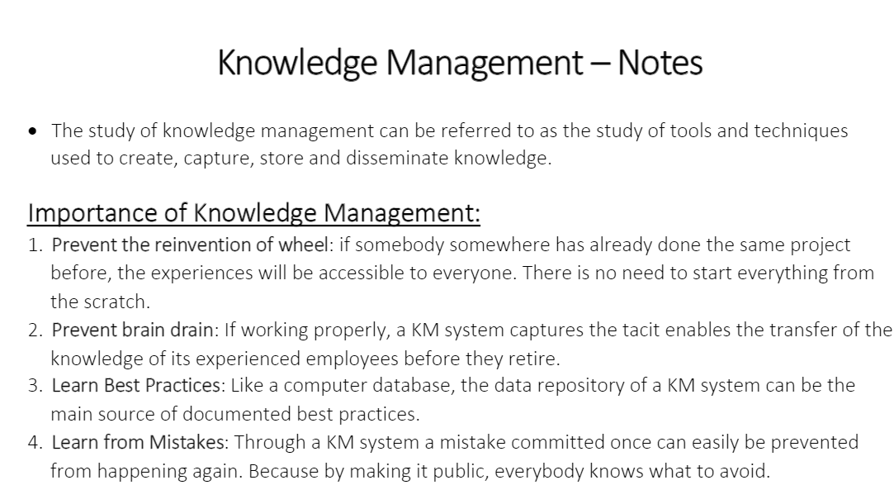

Slide 31
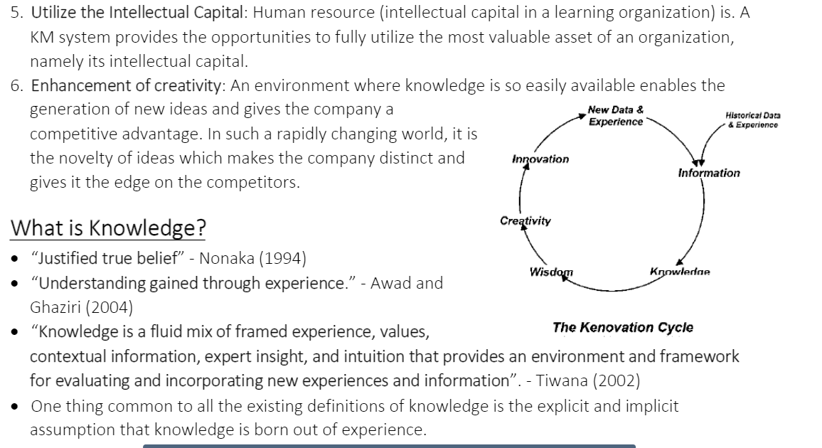

Slide 32
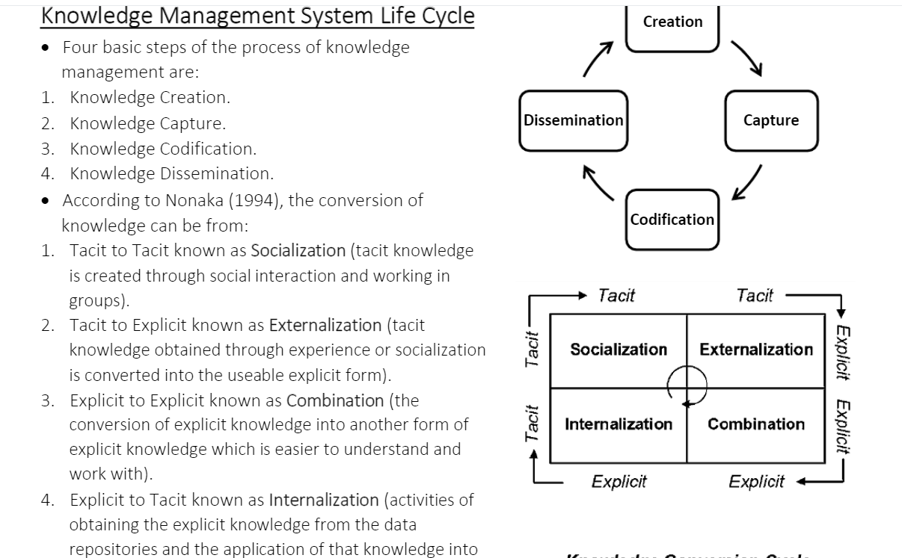

Slide 33
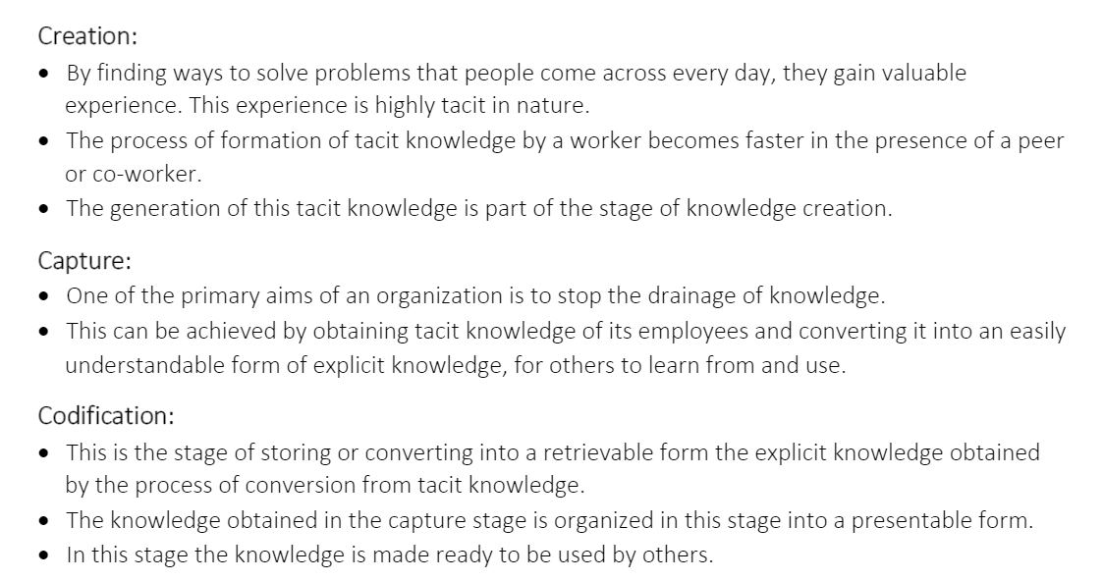

Slide 34
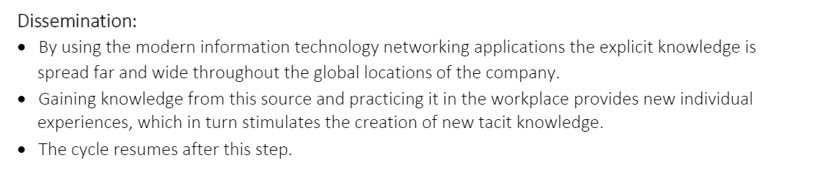

Slide 35
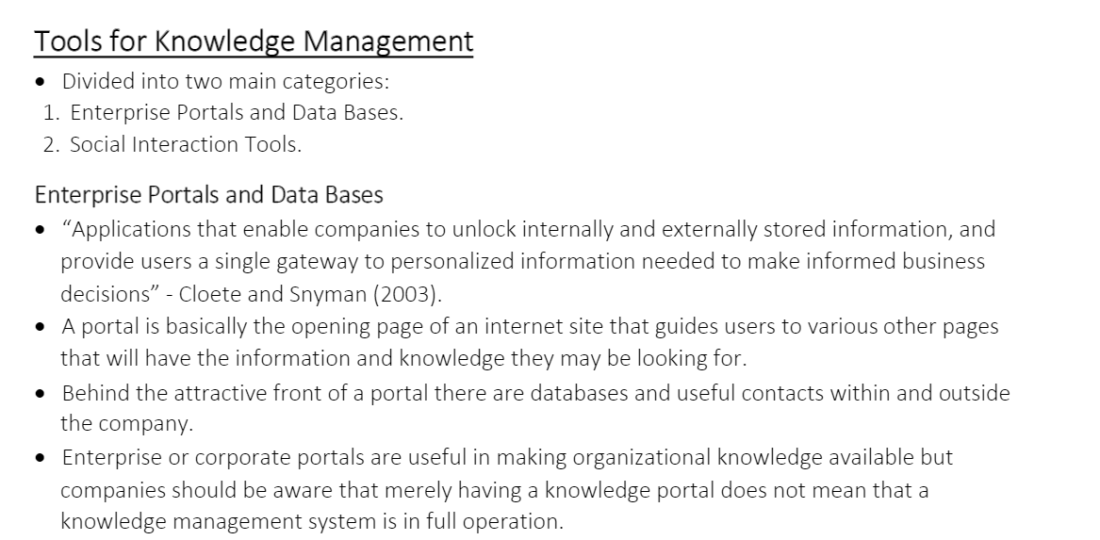

Slide 36
